Slide 1

How to get started

Slide 2
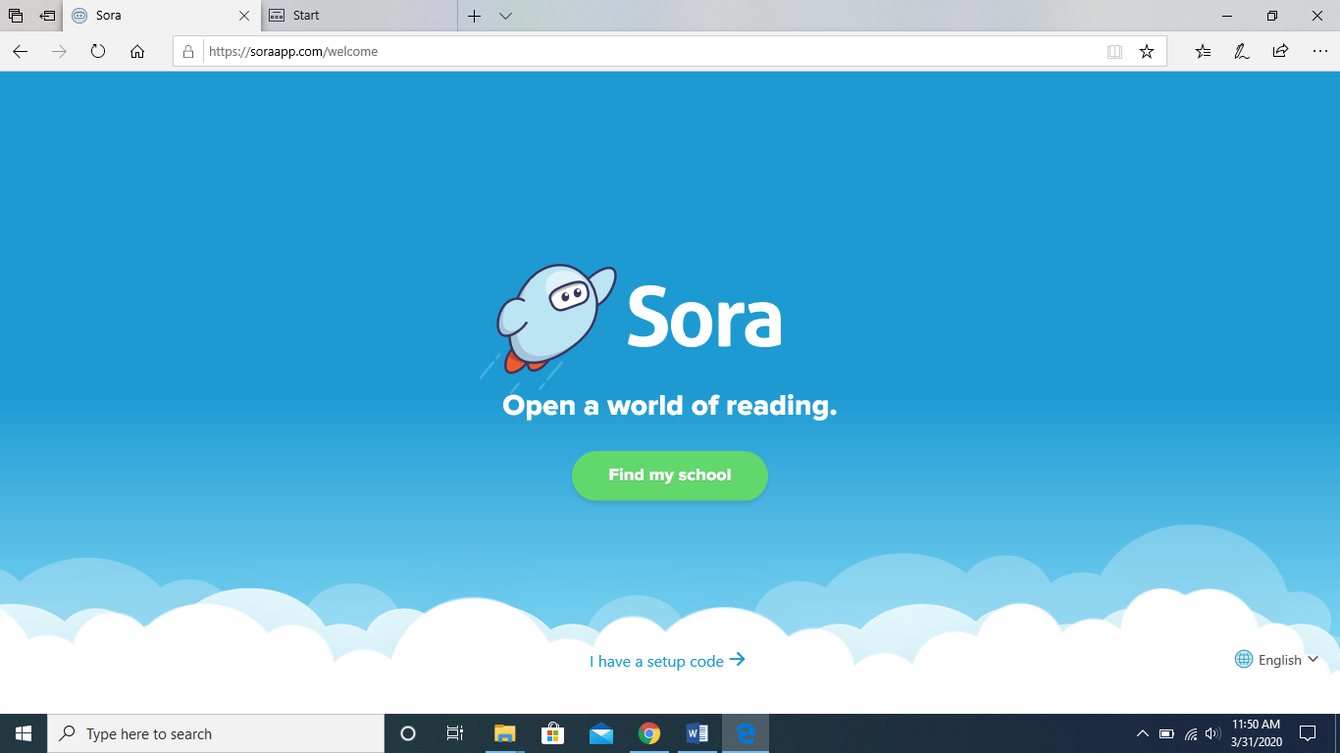
Download the Sora App or go to soraapp.com

Slide 3
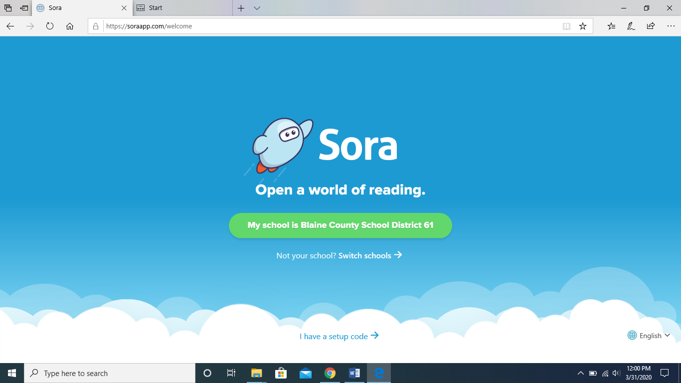
You can change the language of the app here.

Slide 4
Use this button to search for Blaine County School District.
OR
Use the setup code: blaine

Slide 5
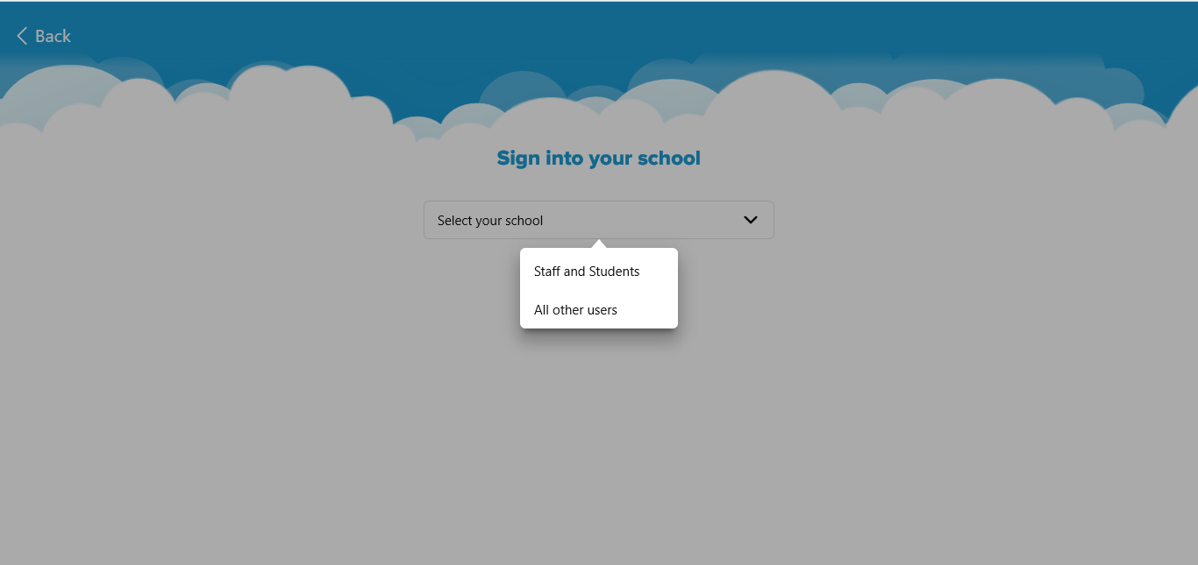
Choose Staff and Students.

Slide 6
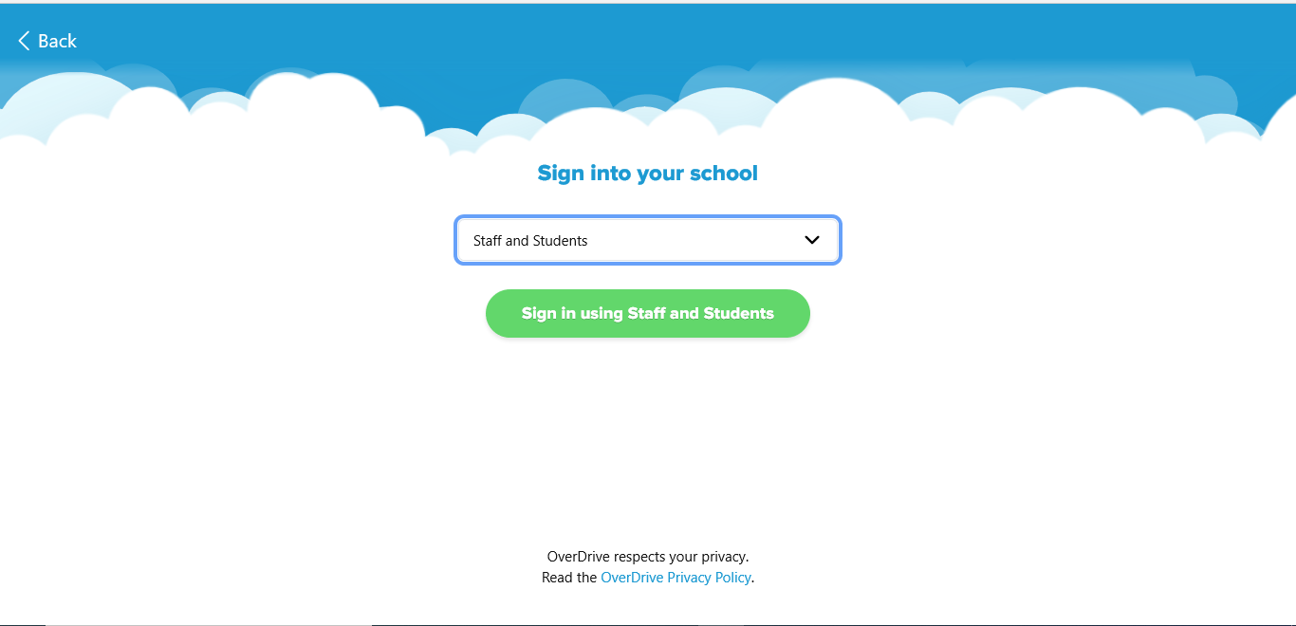
Choose Sign in using Staff and Students.

Slide 7
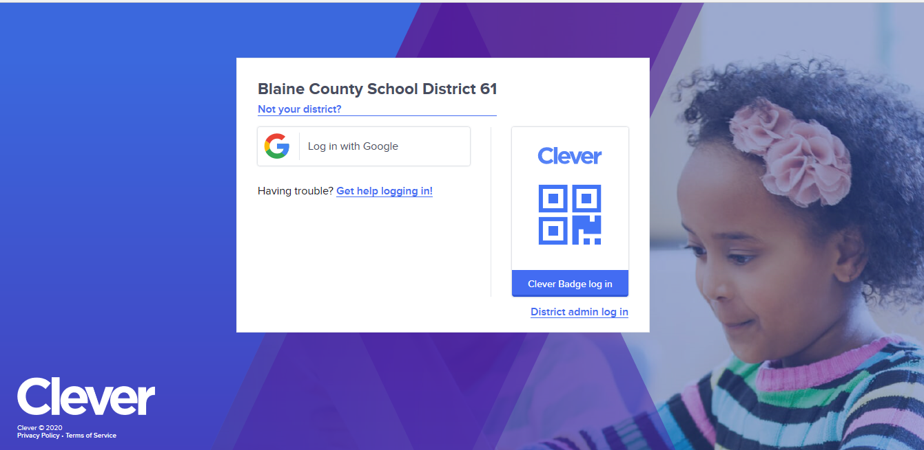
Log in with Google or Clever.

Slide 8
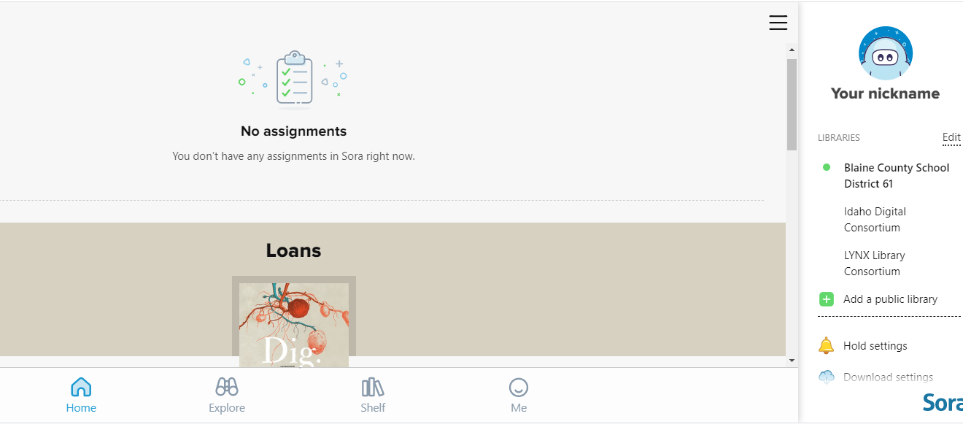
You’re in!
Use these icons to move around the app.

Slide 9


Here’s an overview of Sora:

Slide 10
Contact your school librarian for more help, troubleshooting, or if you have questions.
Find How to Videos here:
https://resources.overdrive.com/k-12-schools/how-to-videos/sora/

Slide 11
Happy Reading!

